Slide 1


DISSEMINATION OF THE
ORS & ZINC STUDY IN
NAROK SOUTH
SUB-COUNTY

Slide 2
Effectiveness of expanded delivery mechanisms/ Channels and empowerment of caregivers on diarrhoea management of children under five years, Narok County, Kenya
Presenter:
Dr Josephat Nyagero, Amref Health Africa
To: National Level Stakeholders
Venue: Panafric Hotel, Nairobi, Sept 29, 2015

Slide 3
Study Investigators
John Nduba, Amref Health Africa
Josephat Nyagero, Amref Health Africa
Bob Akach, Amref Health Africa in Kenya
Elijah Mbiti, Micronutrient Initiative Kenya Office
Josphat Mutua, NCAHU MoH Headquarters
Esther Chula, SCMOH Narok South Sub-County
Jacqueline Kung`u, Micronutrient Initiative Regional Office

Slide 4
Introduction
Diarrhoea contributes to > 20% U5 mortality (MOPHS, 2010)
ORS & Zinc can prevent diarrhoea child deaths by 93% and 21% (UNICEF & WHO 2010)
Access to ORS & Zinc at community is a bottleneck
Although 80% mothers know ORS, 39% with diarrhoea received ORS treatment (KNBS et al, 2010)
<1% of children received zinc supplements (KNBS, 2010) Increased to 8% (KNBS, 2014)
For 2 reasons: Zinc not been available at facilities uniformly, and limited knowledge about its use

Slide 5
Research Question
Can implementation of an innovative mechanism for increasing the mothers’ access to ORS and Zinc and empowering mothers to use them appropriately, lead to at least a 20% increase in the proportion of children with diarrhea who receive Zinc and ORS compared to routine programme implementation?

Slide 6
Objectives
Assess if distributing ORS and Zinc using non-health channels will increase its use in diarrhoea management
Establish if empowering mothers to correctly manage children under five years with diarrhoea at home will improve its use compared to routine programme implementation

Slide 7
Design: Cluster Randomised Controlled Trial

Slide 8
Methodology
Intervention: Enelerai, Olkinyei, Naikara, Entesekera and Ereteti;
Esoit, Melelo, Olchora-Oiruwa, Rongena, Mara rienta, Oloirwa
Control: Lemek, Elangata Enterit, Nkorinkori, Enkutoto, Maji Moto, Morijo Loita; Siana, Mogoimet, Olkiriane, Sagamian Nkoilale.

Slide 9
Population
Primary: children under the age of five with or without diarrhoea and their mothers or primary caregivers
Secondary: health facility workers, community leaders and other key informants including school teachers and administrators, private sector business people, religious leaders, and traditional healers

Slide 10
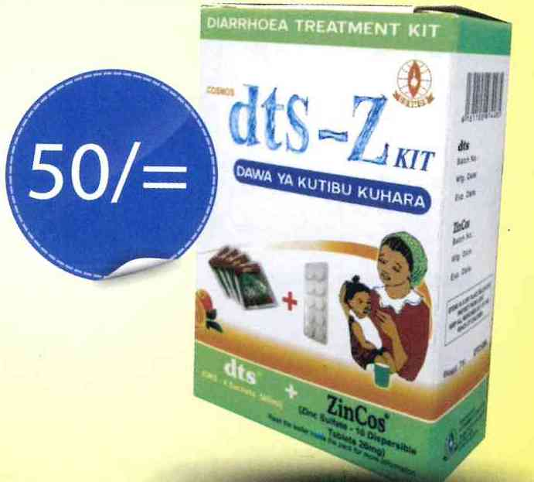
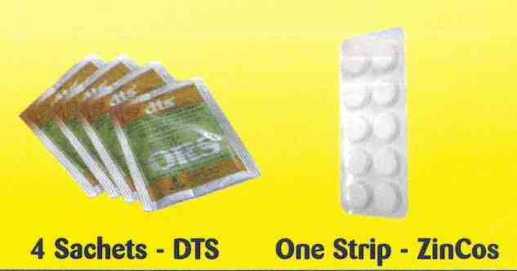
Intervention package
Linkage to an ORS and Zinc manufacturer or large distributor:- COSMOS

Slide 11
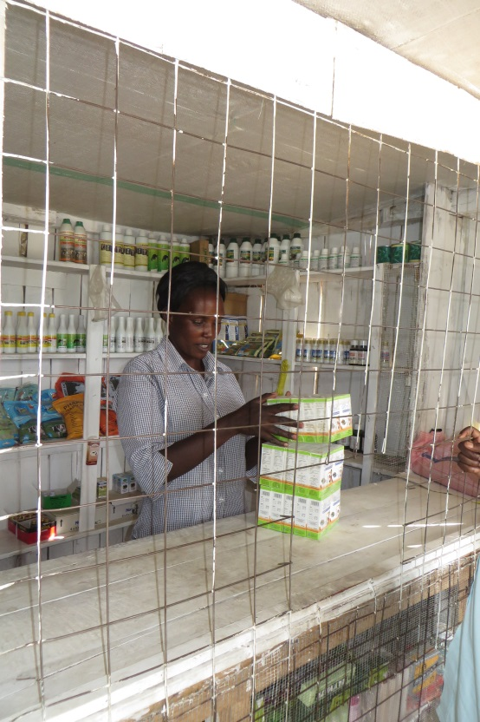
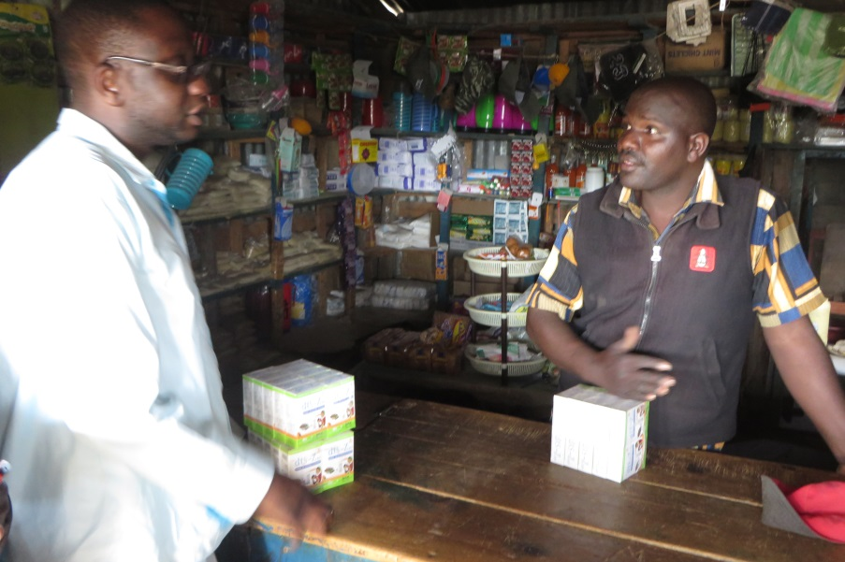
Intervention package
Innovative ORS & Zinc outlets:
  Shop and kiosk owners
  Teachers trained on the use of ORS and Zinc
  FBOs– churches/ mosques
  4,495 co-packs distributed

Slide 12
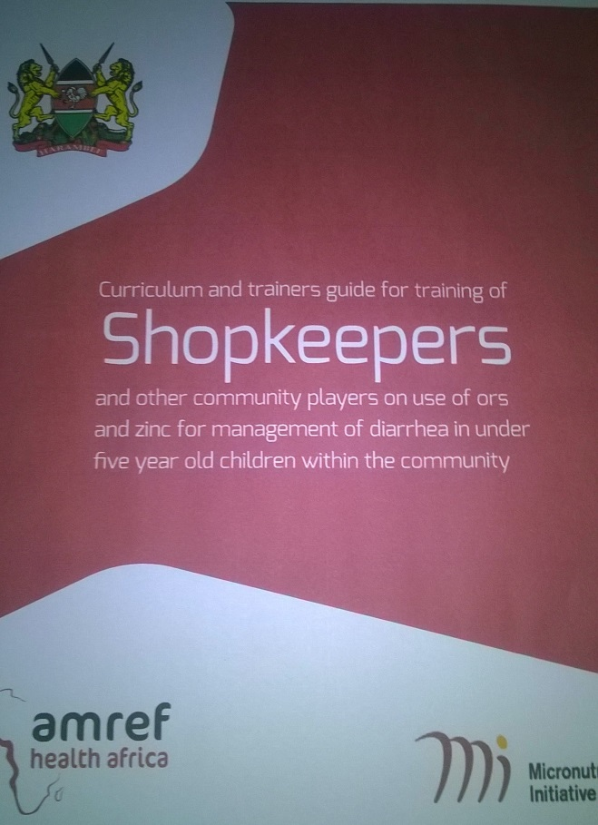
Intervention package
Training: baseline identified knowledge gaps
  9 CHEWs, 74 Shop and kiosk owners, 93 FBOs and 62 teachers
  9,182 Mothers and caregivers

Slide 13
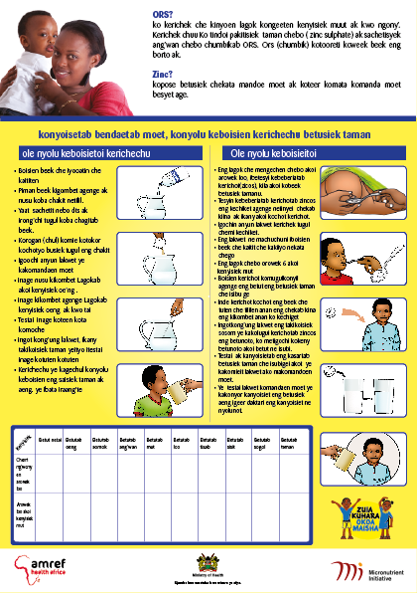

Intervention package
BCC activities:
  model homes, interpersonal, edutainment, IEC materials, market days, religious meetings, chief’s baraza, ceremonies

Slide 14
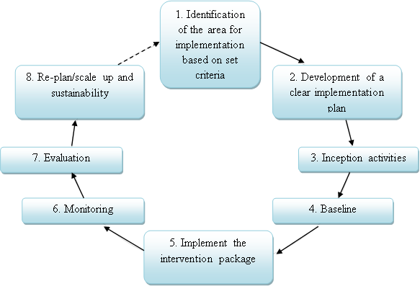
ORS & Zinc delivery mechanism: implementation process
8 steps of innovative
ORS and Zinc delivery
Mechanism
intervention for
increased access
at community
level

Slide 15
Data Collection
On 4th Month April 2013 and 12th of intervention Nov 2014 baseline and end-line survey respectively
Data collection teams were independent of the intervention implementation team
Study instruments to collect the survey data:
  Household Questionnaires M/C (Baseline 6,683 Mother on 10,989 U5s; End-line 6,720 mothers on 10,623)
  Key Informants Interviews (42 Baseline, 15 End-line)
  Focus Group Discussion guides (8 Baseline, 7 End-line)
  Health Facility Assessment Tool (21 Baseline, 15 End-line)

Slide 16
Data analysis and Ethical Issues
Descriptive statistics with the chi square at the 95% CI
Change attributable to intervention (effect size) achieved by Difference-in-Differences (DiD) approach
Qualitative data
  transcribed for 15 voice-recorded FGDs
  objectives used in deriving the themes
  transcriptions entered into Nvivo 10
Amref Health Africa ESRC for ethical approval

Slide 17
Percentage distribution of selected socio-demographic characteristics of the respondents by survey and study arm
Over 95% are Female
Almost 50% aged 20-29 years
70% Maasai
About 50% protestant, 25% African tradition
Mainly housewives or livestock keepers
Characteristics | Baseline |  |  | End-line
 | Total (n=6,683) | Intervention (n=3,306) | Control (n=3,337) | Total (n=6,720) | Intervention (n=3,144) | Control (n=3,576)
Sex of the respondent
Male | 5.4 | 4.5 | 6.4 | 3.6 | 2.3 | 4.7
Female | 94.6 | 95.5 | 93.6 | 96.4 | 97.7 | 95.3
Relationship to HHH
Wife | 82.5 | 81.4 | 83.5 | 85.7 | 85.4 | 86.0
Self | 12.3 | 12.6 | 12.1 | 9.6 | 10.3 | 9.0
Daughter | 3.3 | 4.1 | 2.6 | 2.6 | 2.8 | 2.4
Other Relationship | 1.9 | 1.9 | 1.8 | 1.1 | 0.6 | 1.5
Age of respondent
Below 20 years | 7.7 | 8.5 | 7.0 | 8.0 | 7.5 | 8.4
20 – 29 | 48.5 | 49.6 | 47.3 | 49.9 | 52.5 | 47.5
30 – 39 | 23.7 | 24.1 | 23.2 | 23.6 | 22.1 | 25.0
40 - 49 | 7.2 | 7.6 | 6.8 | 5.3 | 4.6 | 5.9
50 years or longer | 2.0 | 2.0 | 2.1 | 1.1 | 1.1 | 1.1
Don’t know | 11.0 | 8.2 | 13.7 | 12.0 | 12.2 | 11.9
Respondent’s Ethnicity
Maasai | 70.5 | 67.3 | 73.6 | 70.0 | 64.3 | 75.0
Kipsigis | 26.4 | 29.1 | 23.7 | 27.2 | 31.1 | 23.7
Kisii | 1.4 | 1.8 | 1.0 | 0.8 | 1.2 | 0.4
Kikuyu | 0.9 | 0.9 | 0.9 | 0.6 | 0.8 | 0.5
Others | 0.8 | 0.8 | 0.7 | 1.4 | 2.5 | 0.4
Religion of the respondent
Protestant | 43.8 | 47.9 | 39.8 | 50.9 | 55.5 | 46.9
Traditional African | 34.7 | 30.2 | 39.2 | 26.8 | 25.3 | 28.1
Catholic | 18.2 | 19.3 | 17.1 | 20.3 | 17.6 | 22.7
Muslim | 0.3 | 0.3 | 0.4 | 0.3 | 0.3 | 0.3
None | 3.0 | 2.4 | 3.6 | 1.7 | 1.3 | 2.0
Main occupation
Housewife | 45.6 | 43.6 | 47.6 | 54.4 | 42.7 | 64.7
Farmer | 15.1 | 14.9 | 15.2 | 11.3 | 13.4 | 9.5
Livestock keeper | 14.8 | 14.1 | 15.2 | 9.9 | 15.0 | 5.3
Mixed farming | 14.2 | 16.6 | 11.9 | 11.0 | 13.0 | 9.2
Trader | 7.7 | 7.9 | 7.6 | 2.7 | 2.3 | 3.1
Salaried | 2.0 | 2.1 | 1.8 | 9.9 | 12.8 | 7.4
Others | 0.6 | 0.8 | 0.5 | 0.8 | 0.7 | 0.8

Slide 18
Percentage distribution of selected socio-demographic characteristics of children by survey and study arm
Most have 1 or 2 U5s
Slightly more than 50% are male in conformity with age specific sex ratio for age group
Even age distribution in months
Over 90% were child’s mother
Characteristics | Baseline |  |  |  | End-line
 | Total (n=10,989) |  | Intervention (n=5,497) | Control (n=5,492) | Total (n=10,623) | Intervention (n=5,194) | Control (n=5,429)
Children per household
One |  | 51.6 | 50.3 | 52.9 | 33.4 | 28.6 | 38.0
Two |  | 35.1 | 35.9 | 34.3 | 41.3 | 44.6 | 38.1
Three |  | 12.5 | 13.2 | 11.9 | 23.2 | 24.4 | 22.0
Four or more |  | 0.8 | 0.6 | 0.9 | 2.1 | 2.4 | 1.9
Sex of the child
Male |  | 51.2 | 52.1 | 50.3 | 53.0 | 51.7 | 54.3
Female |  | 48.8 | 47.9 | 49.7 | 46.0 | 47.2 | 44.9
Not specified |  | - | - | - | 0.9 | 1.1 | 0.8
Age of child (in month)
0 – 6 |  | 8.9 | 9.0 | 8.9 | 10.9 | 11.1 | 10.6
7 – 12 |  | 13.1 | 12.5 | 13.7 | 14.1 | 13.4 | 14.7
13 – 24 |  | 21.7 | 21.4 | 22.0 | 22.5 | 21.1 | 23.8
25 – 36 |  | 21.2 | 20.3 | 22.0 | 21.9 | 21.0 | 22.8
37 – 48 |  | 17.7 | 18.2 | 17.2 | 17.2 | 17.8 | 16.5
49 – 60 |  | 17.4 | 18.6 | 16.2 | 13.5 | 15.5 | 11.5
Relationship to child
Mother |  | 91.7 | 92.2 | 91.2 | 93.6 | 95.3 | 92.0
Father |  | 4.2 | 3.4 | 5.1 | 2.3 | 1.5 | 3.0
Sister |  | 1.4 | 1.4 | 1.3 | 1.3 | 0.8 | 1.8
Brother |  | 0.5 | 0.6 | 0.5 | 1.0 | 0.6 | 1.5
Other |  | 2.2 | 2.4 | 1.9 | 1.7 | 1.8 | 1.6

Slide 19
Percentage accessibility to water source and households’ hygiene and sanitation by survey and study arm
Rain catchment is main source in wet season (Is it safe?)
Improved pipe water (control), 2.4 to 10.9 (County Government?)
Half HHs access from improved source (Wet)
2 in every 10 during dry season
Characteristics | Baseline |  |  |  | End-line
 | Total (n=6,683) |  | Intervention (n=3,306) | Control (n=3,377) | Total (n=6,720) | Intervention (n=3,144) | Control (n=3,576)
Main source of water during wet season
Improved source
Rain catchment |  | 39.2 | 48.3 | 30.4 | 41.0 | 49.0 | 34.0
Tank |  | 3.8 | 4.0 | 3.6 | 4.1 | 1.3 | 6.5
Piped |  | 2.9 | 0.9 | 4.8 | 6.9 | 2.4 | 10.9
Protected spring |  | 1.9 | 1.0 | 2.8 | 6.6 | 4.6 | 8.4
Borehole |  | 1.6 | 2.1 | 1.2 | 0.5 | 0.1 | 0.9
Protected well |  | 1.2 | 0.8 | 1.7 | 0.7 | 0.5 | 0.9
Non-improved source
River |  | 23.6 | 20.2 | 27.0 | 17.6 | 18.4 | 16.9
Open spring |  | 15.8 | 13.7 | 17.8 | 15.1 | 17.8 | 12.7
Open pond |  | 4.2 | 5.2 | 3.3 | 5.7 | 4.3 | 6.9
Open dug well |  | 4.1 | 3.5 | 4.7 | 1.5 | 1.1 | 1.8
Water pan |  | 1.6 | 0.2 | 2.9 | 0.2 | 0.4 | 0.2
% using any improved source |  | 50.6 | 57.1 | 44.5 | 59.9 | 57.9 | 61.6
% using any improved source |  | 18.6 | 13.8 | 23.3 | 27.0 | 16.3 | 36.4

Slide 20
Percentage accessibility to water source and households’ hygiene and sanitation by survey and study arm
Characteristics | Baseline |  |  | End-line
 | Total (n=6,683) | Intervention (n=3,306) | Control (n=3,377) | Total (n=6,720) | Intervention (n=3,144) | Control (n=3,576)
Water storage method at HH
Same fetching container | 60.2 | 54.4 | 65.8 | 55.7 | 50.3 | 60.5
Covered container | 29.0 | 33.6 | 24.5 | 37.5 | 42.5 | 33.0
Open container | 10.8 | 12.0 | 9.6 | 6.6 | 6.8 | 6.4
Others (pot and tank) | 0.1 | 0.1 | 0.1 | 0.3 | 0.4 | 0.1
Drinking water treated | 24.1 | 29.1 | 19.1 | 20.2 | 23.5 | 17.3
Boiling | 15.8 | 18.6 | 13.0 | 13.1 | 14.7 | 11.6
Adding chemical | 8.1 | 10.3 | 6.0 | 6.5 | 7.7 | 5.5
Others (sieving/ in sun) | 0.2 | 0.3 | 0.1 | 0.6 | 1.1 | 0.2
Presence of utensils drying rack | 65.3 | 63.9 | 66.8 | 75.0 | 68.0 | 81.1
Clean compound | 50.2 | 48.4 | 51.9 | 62.3 | 55.6 | 68.2
Clean dwelling | 66.4 | 63.3 | 69.5 | 82.4 | 76.5 | 87.6
Sharing sleeping space with animals | 49.3 | 46.7 | 51.9 | 36.7 | 38.1 | 35.5
Presence of latrine | 25.3 | 25.0 | 25.6 | 26.0 | 29.6 | 22.9
Increased use of covered containers for storage
No major changes in water treatment
Increased use of utensil racks
Slight increase in latrine coverage from 25.3 to 26%

Slide 21
Percentage accessibility to water source and households’ hygiene and sanitation by survey and study arm
There is scarcity of drinking water in this area with a health provider explaining that:
“people in this community especially when it is dry collect stagnant water used for irrigation and use it for consumption. The health risks are worse as they don’t boil it before drinking”.
On latrine coverage a key informant said:
“…there were no toilets except only in schools and the health facility”

Slide 22
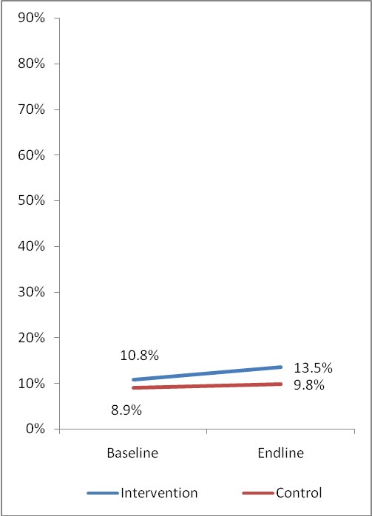
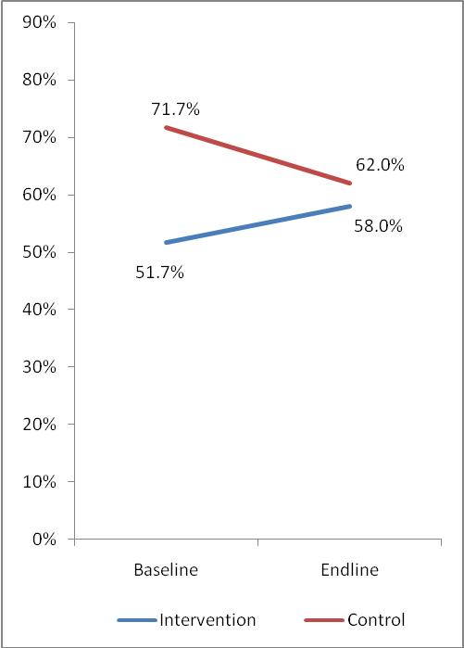
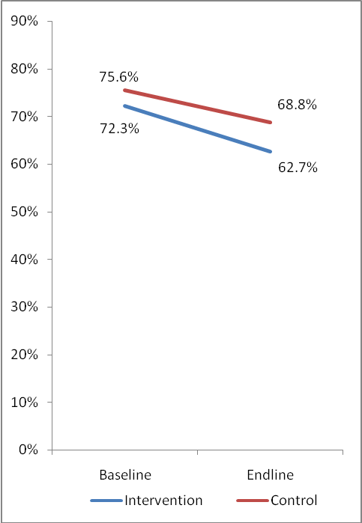
Latrine coverage by study arm and Ethnicity
Maasai
Kipsigis
Others
P=0.085
P<0.001
P=0.593
P=0.448
P=0.029
P<0.001
Latrine coverage increased among Maasai in both I and C sites with more pronouncement in the intervention

Slide 23
Source of knowledge on diarrhoea prevention and treatment by study arm and survey
Characteristics | Baseline |  |  | End-line
 | Total (n=6,683) | Intervention (n=3,306) | Control (n=3,377) | Total (n=6,720) | Intervention (n=3,144) | Control (n=3,576)
Public health facility | 63.4 | 63.1 | 64.4 | 75.6 | 74.3 | 76.8
Family members | 25.0 | 24.3 | 25.7 | 22.6 | 18.4 | 26.6
Private facility | 11.1 | 8.6 | 13.5 | 16.0 | 13.6 | 18.3
Herbalist | 4.7 | 4.6 | 4.7 | 6.8 | 2.5 | 10.8
CHVs | 4.2 | 3.5 | 5.0 | 9.3 | 10.9 | 7.7
Community training | 3.7 | 4.9 | 3.7 | 8.1 | 11.4 | 5.0
Others | 3.7 | 6.1 | 1.4 | 1.6 | 1.5 | 1.7
Radio/Newspaper | 3.3 | 3.5 | 3.1 | 12.5 | 10.3 | 14.5
Church | 1.4 | 1.3 | 1.4 | 4.6 | 6.4 | 2.9
Written pamphlet | 0.7 | 0.4 | 1.1 | 0.9 | 0.5 | 1.3
Amref health Africa | 0.02 | 0.04 | 0.01 | 12.6 | 20.8 | 4.8
Increased sources: Public HF & Radio
Intervention only: CHVs, Community training , Church and Amref Health Africa

Slide 24
Knowledge of where caregivers/mothers can obtain ORS and Zinc by survey and study arm
Characteristics | Baseline |  |  | End-line
 | Total (n=6,683) | Intervention (n=3,306) | Control (n=3,377) | Total (n=6,720) | Intervention (n=3,144) | Control (n=3,576)
Where one can obtain ORS (multiple response)
Public Health facility | 61.2 | 65.0 | 57.5 | 76.0 | 78.6 | 73.6
Pharmacy | 4.0 | 3.7 | 4.4 | 15.8 | 18.2 | 13.6
Shop | 2.7 | 1.2 | 4.1 | 27.6 | 30.6 | 25.1
Community Health Volunteers | 2.5 | 1.5 | 3.6 | 6.7 | 7.6 | 5.9
Traditional practitioner | 0.8 | 0.1 | 1.5 | 0.6 | 0.2 | 0.9
Friend / Relative | 0.4 | 0.4 | 0.5 | 0.7 | 0.9 | 0.5
Increased sources:
  Public HF, Pharmacy, Shop
  Increased intervention only: CHVs
Effects of radio IEC campaign which ran at the same time contaminating the control

Slide 25
Adequate knowledge on management of diarrhoea among mothers/ caregivers of the children by study arm
(p<0.001)
Increased adequate knowledge
  Comparisons
  11.8% to 42.6% (30.8%);
  Intervention arm
  8.3% to 52% (43.7%);
Intervention effect size using DiD approach
= (β – α)
= 12.9%.
(p<0.001)
(p<0.001)

Slide 26
Summary of the Qualitative Findings at both Baseline and End-line
Themes | Baseline | End-line
Causes of Diarrhoea | Teething in babies Breastfeeding while pregnant Engaging in sex while breastfeeding | Poor hygiene practices: consumption of dirty food and water, not washing hands before eating/ feeding or after visiting latrines Complication from another existing illness Teething in babies
Prevention of Diarrhoea | Use Herbs Deworming of the children | Improving on hygiene practices: washing hands before feeding/ eating and after visiting latrines Construction and use of latrines for human waste disposal Boiling/ treating drinking water Provision of safe drinking water in the community Deworming of the children
Treatment of Diarrhoea | Traditional medicine (Herbs) Give alcohol and bitter herbs | Give mixture of water with sugar/ salt to the child Use traditional medicine (herbs) Use ORS and Zinc
Sources of advice | Laibons Traditional Birth Attendants | Herbalist Health facility Shops dispensing ORS and Zinc Old women in the village, e.g. mother in law

Slide 27
Prevalence of diarrhoea
Two weeks preceding data collection, overall dropped from 20.4% at baseline to 14.9% at end-line; (p<0.001); resulting to 5.5% reduction
Between groups
  Intervention declined: 21.4% to 15% (β = 6.4%)
  Control declined: 19.5% to 14.9% (α = 4.6%)
Reduction in occurrence of diarrhoea attributable to the intervention (effect size; β-α was 1.8%)

Slide 28
Action taken during diarrhoea by study arm and survey
Action taken during the illness | Baseline |  |  | End-line
 | Total n=2,245 | Intervention n=1,175 | Control n=1,070 | Total n=1,588 | Intervention n=777 | Control n=811
Nothing | 31.0 | 33.0 | 28.8 | 22.3 | 25.4 | 19.4
Sought care from GoK HF | 38.8 | 34.0 | 43.9 | 47.0 | 45.3 | 48.7
Used home remedy | 18.8 | 24.3 | 12.7 | 14.3 | 11.2 | 17.3
Sought care from private clinic | 7.6 | 4.6 | 10.8 | 7.1 | 5.4 | 8.8
Bought ORS and Zinc from shop | 2.1 | 2.2 | 2.0 | 5.9 | 9.5 | 2.3
Got ORS and Zinc from other sources | 0.4 | 0.3 | 0.5 | 0.7 | 0.6 | 0.7
Sought care from CHV | 1.5 | 1.6 | 1.3 | 2.7 | 2.6 | 2.8
Declining proportion of caregivers who do nothing
Buying from shop in intervention increased

Slide 29
Use of ORS and Zinc among children experiencing diarrhoea in the last two weeks by study arm
Overall ORS and Zinc at baseline was 5.1% and 28.6% at end-line
Within group comparisons
  Control: End-line (18.7%) compared to baseline (7.2%); (p<0.001) with 11.5%; denoted as α
  Intervention: End-line (38.4%) compared to baseline (3.1%); (p<0.001), with 35.3%; denoted as β).
Change in use of ORS and Zinc attributable to the intervention (effect size; β-α) was 23.8%

Slide 30
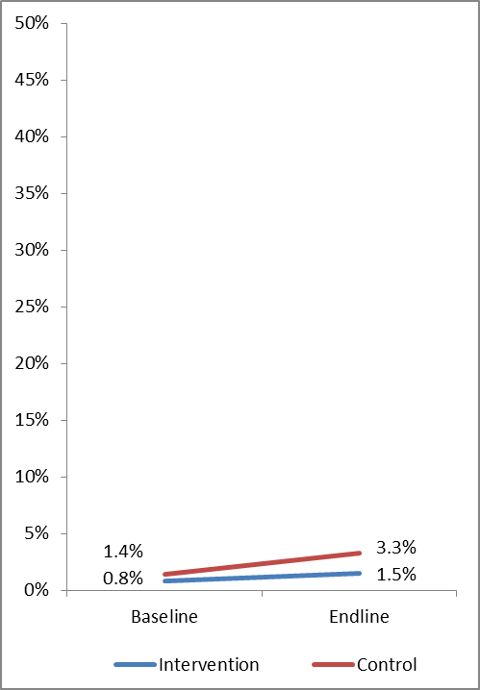
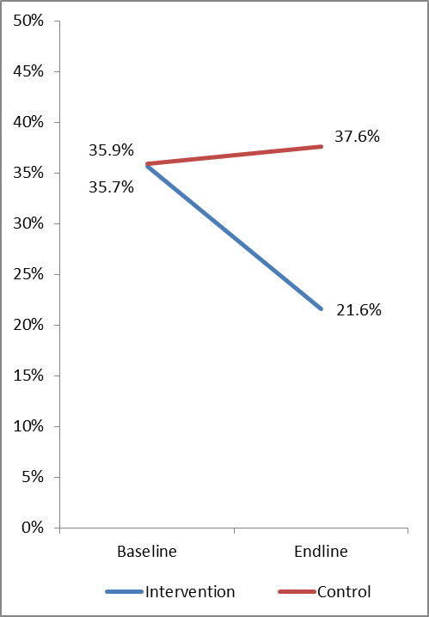
Use of Zinc only and ORS only among children experiencing diarrhoea in the last two weeks by study arm
Zinc Only
Overall use of zinc only at baseline was 1.1% and 2.4% at end-line (8% KNBS et al, 2014)
Increase higher in control than Intervention
ORS Only
Overall use of ORS only at baseline was 35.8% and 29.6% at end-line (xx% KNBS et al, 2014)
A sharp decline observed in Intervention compared to slight increase for the control
Used Zinc only
Used ORS only
(p<0.001)

Slide 31
Distribution of preferred sources of ORS and Zinc in management of diarrhoea
Characteristics | Baseline |  |  | End-line
 | Total (n=1,549) | Intervention (n=787) | Control (n=762) | Total (n=6,720) | Intervention (n=3,144) | Control (n=3,576)
Preferred ORS/zinc sources
Health facility | 65.3 | 66.6 | 64.0 | 62.0 | 51.1 | 71.7
Shop/kiosk | 13.9 | 15.0 | 12.9 | 21.6 | 31.0 | 13.1
Private clinic | 4.8 | 2.2 | 7.5 | 7.4 | 6.1 | 8.6
Local school | 3.4 | 2.5 | 4.2 | 0.3 | 0.7 | 0.0
Pharmacy | 2.7 | 2.8 | 2.6 | 2.3 | 2.4 | 2.2
CHV | 2.1 | 3.2 | 0.9 | 2.6 | 3.8 | 1.6
Church/Mosque | 1.6 | 1.7 | 1.6 | 0.3 | 0.7 | 0.0
Others | 6.2 | 6.1 | 6.3 | 3.5 | 4.2 | 2.8
Others sources; – home distribution and herbalist

Slide 32
Willingness to buy diarrhoea medicine at Kshs 50 by study arm
Characteristics | Baseline |  |  | End-line
 | Total (n=6,683) | Intervention (n=3,306) | Control (n=3,377) | Total (n=6,720) | Intervention (n=3,144) | Control (n=3,576)
Will buy diarrhoea medicine at 50/=
Yes | 75.6 | 76.4 | 74.9 | 83.5 | 85.8 | 81.5
No | 24.4 | 23.6 | 25.1 | 16.5 | 14.2 | 18.5
Amount willing to buy if <50/= (n=2,677)
None (free) | 25.9 | 26.8 | 25.1 | 14.3 | 17.7 | 12.1
Ksh 5 | 2.6 | 2.3 | 2.8 | 1.4 | 0.4 | 2.0
Ksh 10 | 17.0 | 18.9 | 15.1 | 24.0 | 18.6 | 27.6
Ksh 15 | 1.1 | 1.5 | 0.8 | 1.5 | 0.9 | 2.0
Ksh 20 | 37.1 | 33.4 | 40.7 | 29.8 | 28.7 | 30.5
Ksh 25 | 2.0 | 2.2 | 1.9 | 5.1 | 6.1 | 4.5
Kshs 30 | 13.1 | 13.8 | 12.5 | 19.9 | 23.3 | 17.6
Kshs 35 | 0.1 | 0.1 | 0.1 | 0.2 | 0.4 | 0.0
Kshs 40 | 1.1 | 1.2 | 1.0 | 3.8 | 3.8 | 3.8

Slide 33
Conclusions
Some positive attitudes and practices e.g improved hygiene, covering of drinking water, use of dish racks, clean compound, increased latrine coverage etc will contribute to diarrhoea reduction
Empowerment of mothers and caregivers increased to >20% the knowledge on diarrhoea home management
Declining diarrhoea prevalence
Improved practices in diarrhoea management
Alternative mechanisms for delivery of ORS and Zinc contributing to >20% to its use in diarrhoea management

Slide 34
Recommendations
Some positive practices eg improved hygiene, covering of drinking water, use of dish racks, clean compound, increased latrine coverage etc all will contribute to diarrhoea reduction
Increased knowledge on diarrhoea home management
Declining diarrhoea prevalence
Improved practices in diarrhoea management
Alternative mechanisms for delivery of ORS and Zinc contributing to its use in diarrhoea management
Scale-up the innovative mechanisms of delivery of ORS and Zinc especially the hard to reach communities
Integrated health promotion activities using existing community structures for expanded gains in diarrhoea management (WASH and CLTS)
Supply chain for ORS and Zinc be agreed with the full participation of communities
Train shopkeepers and other ORS dispensers using the already tested curriculum and trainer’s guide

Slide 35
Acknowledgement
Some positive practices eg improved hygiene, covering of drinking water, use of dish racks, clean compound, increased latrine coverage etc all will contribute to diarrhoea reduction
Increased knowledge on diarrhoea home management
Declining diarrhoea prevalence
Improved practices in diarrhoea management
Alternative mechanisms for delivery of ORS and Zinc contributing to its use in diarrhoea management
Ministry of Health for prioritizing caregivers’ access to ORS and Zinc as a research issue for Kenya
Micronutrient Initiative and Amref Health Africa for co-funding the study
Narok County Government for enormous support at the local level
The Mothers of Narok Sub County
Shopkeepers and other ORS and Zinc dispensers for their time and service to mothers of Narok South

Slide 36
Recommendations
Some positive practices eg improved hygiene, covering of drinking water, use of dish racks, clean compound, increased latrine coverage etc all will contribute to diarrhoea reduction
Increased knowledge on diarrhoea home management
Declining diarrhoea prevalence
Improved practices in diarrhoea management
Alternative mechanisms for delivery of ORS and Zinc contributing to its use in diarrhoea management
Thank you,
Asanteni Sana

